Slide 1

LT1670 – Leveraging Machine Learning for Multi-Script to Ansible Conversion.
Britley Hoff
Technology Owner zLinux BCBSSC
Sovereign AI advocate
.
My LinkedIn Profile

Slide 2
Legacy scripts are the silent killers of infrastructure scalability. To modernize, you need a bridge from procedural Bash to declarative Ansible.
This lightning talk explores the AI approach to modernization of those Legacy scripts.
We will be using the sovereign approach of using RHEL 10, Ollama, and Llama LLMs. While this will be the primary discussion, but we could use the enterprise-grade Ansible Lightspeed service. Learn how to serve your own conversion models on-prem to maintain data privacy while rapidly refactoring legacy logic into idempotent playbooks. Whether you choose the cloud-connected convenience of Lightspeed or a local Llama instance, the era of manual script translation is over.

Slide 3
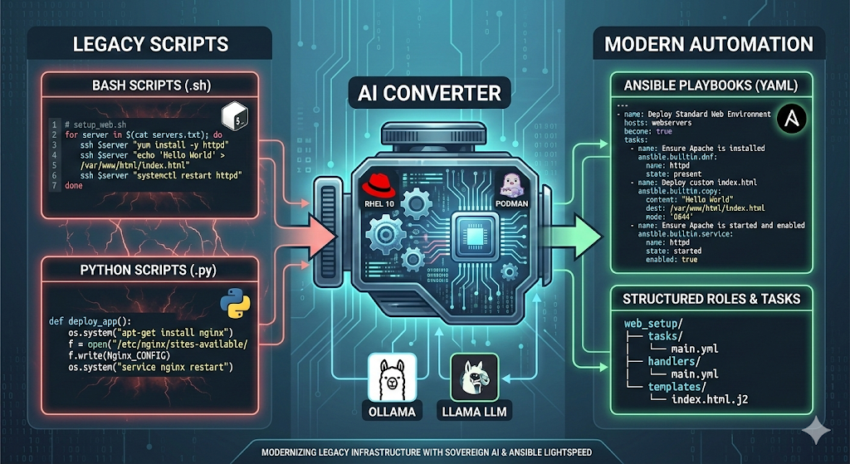

Slide 4
The Enterprise Path: Ansible Lightspeed
Best for: Corporate compliance, team collaboration, and certified content.
Mechanism: Uses IBM watsonx Code Assistant.
Workflow: You type a comment in VS Code; it suggests a full, high-quality task.

Slide 5
The Sovereign Path: RHEL 10 + Ollama
Best for: Air-gapped environments, high privacy, or cost-saving on API tokens.
Mechanism: Running ollama as a systemd service on RHEL 10.
Workflow:
Install: curl -fsSL https://ollama.com/install.sh [ollama.com] | sh
Run: ollama pull llama3.3 (or the latest 2026-equivalent)

Slide 6
Feature | Ansible Lightspeed | RHEL 10 + Ollama
Connectivity | SaaS (Connected) | Local (Offline)
Hardware | Cloud-based | Local GPU/NPU (NVIDIA/AMD)
Training Data | Red Hat curated & certified | General Purpose (Llama)
Best Use Case | Large-scale enterprise teams | Secure/Edge environments

Slide 7
The (Legacy Bash)
# setup_web.sh for server in $(cat servers.txt); do ssh $server "yum install -y httpd" ssh $server "echo 'Hello World' > /var/www/html/index.html" ssh $server "systemctl restart httpd" done

Slide 8
The "Modern State" (Llama-Generated Ansible)
- name: Deploy Standard Web Environment hosts: webservers become: true tasks: - name: Ensure Apache is installed ansible.builtin.dnf: name: httpd state: present - name: Deploy custom index.html ansible.builtin.copy: content: "Hello World" dest: /var/www/html/index.html mode: '0644' - name: Ensure Apache is started and enabled ansible.builtin.service: name: httpd state: started enabled: true

Slide 9
You can grab my custom ollama Modelfile from my gitrepo here https://github.com/wren-creator/red-hat-conference.git
Then run
ollama create ansible-modernizer -f Modelfile.ansible
ollama run ansible-modernizer
or
cat legacy_script.sh | ollama run ansible-modernizer > new_playbook.yml
Or use my Modernizer-validator script also found in my gitrepo https://github.com/wren-creator/red-hat-conference.git This script will take in a Directory of legacy scripts and convert them to Ansible playbooks and then verify with lint.

Slide 10
1. Kill the Legacy
Stop manually translating legacy Bash and Python. Use AI as your Rosetta Stone to move from fragile, procedural scripts to stable, declarative Ansible playbooks.
2. Choice of Engine: SaaS or Sovereign
Ansible Lightspeed: Use the enterprise-grade, IBM watsonx-powered service for certified content and team-wide consistency.
RHEL 10 + Ollama: Deploy a Sovereign AI pipeline for air-gapped environments or sensitive internal logic using Llama models running locally on Podman.
3. Trust, but Lint
AI handles the heavy lifting, but Red Hat tooling (like ansible-lint) provides the guardrails. A local pipeline doesn't just convert, it validates, ensuring your new automation is production-ready from second one.

Slide 11
The goal isn't just to replace a script; it's to transform how we manage infrastructure. Whether you're using Lightspeed in the cloud or Llama on RHEL 10, you're no longer a translator, you're an architect.
See you at the Ansible booth!

